Slide 1
DATA MANAGEMENT

Slide 2
What is Data Management
Data Management is a group of activities relating to the planning, development, implementation and administration of systems for the acquisition, storage, security, retrieval, dissemination, archiving and disposal of data.
Data Management is a comprehensive collection of practices, concepts, procedures, processes, and a wide range of accompanying systems that allow for an organization to gain control of its data resources.
Data Management as an overall practice is involved with the entire lifecycle of a given data asset from its original creation point to its final retirement, how it progresses and changes throughout its lifetime through the internal (and external) data streams of an enterprise.

Slide 3
The Data Management Book of Knowledge (DMBOK) refers to Data Management (or Data Resource Management) as:
“The development and execution of architectures, policies, practices and procedures that properly manage the full data lifecycle needs of an enterprise.” As well as, “The planning, execution, and oversight of policies, practices and projects that acquire, control, protect, deliver, and enhance the value of data and information assets.”

Slide 4
Data Operations Management is also a central function of the entire Data Management Framework and is:
“The development, maintenance and support of structured data to maximize the value of the data resources to the enterprise. Data operations management includes two sub-functions: database support and data technology management.”
While the above definition says structured data, the definition needs to be expanded to include semi-structured and unstructured data that now exists due to the rise of such contemporary Data Management trends like Big Data, Cloud Computing, Machine Learning, Data Lakes, and the Internet of Things

Slide 5
Implies an understanding of the data usage requirements, characteristics and lifecycle and employing them to manage data on physical and logical storage devices.
Key Data Management activities include: • Data Policy development; • Data Ownership; • Metadata Compilation; • Data Lifecycle Control; • Data Quality; and • Data Access and Dissemination.

Slide 6
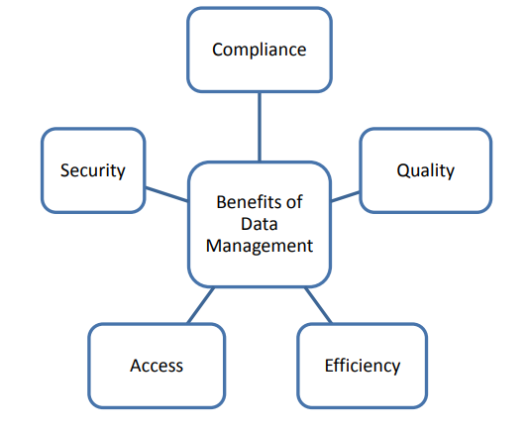
Why do we need to manage our data?
Effective data management guarantees that data is accurate, aligned with business objectives and used to drive better business decisions.

Slide 7
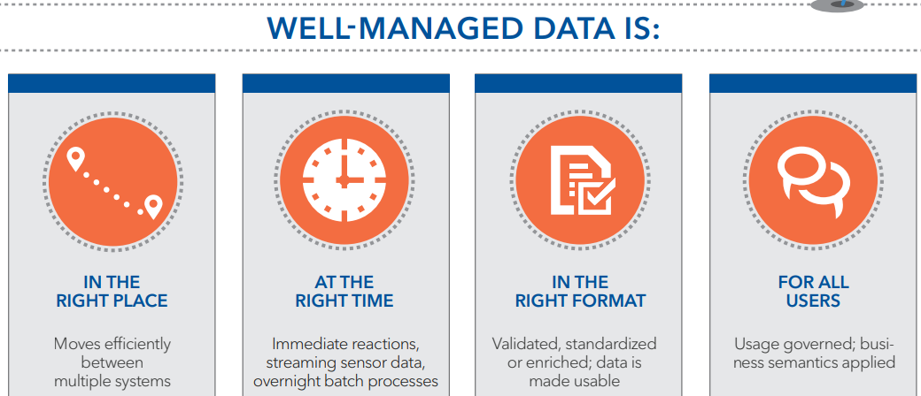

Slide 8
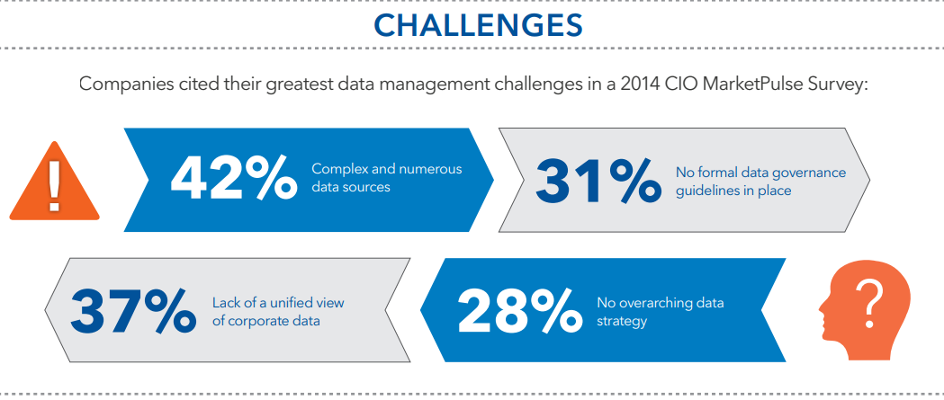

Slide 9
Master data – what is it?
Master data is data shared across computer systems in the enterprise.
Master data is the dimension or hierarchy data in data warehouses and transactional systems
Master data is core business objects shared by applications across an enterprise
Slowly changing Reference data shared across systems
Master data is data worth managing

Slide 10
Master data vs. Metadata vs. Transactional
Transactional
Company | Country | Account | Sub-Account | Date | Amount
Affecto | NO | 505050 | 500 | 20080301 | KR30.000
Metadata
Company | Country | Account | Sub-Account | Date | Amount
Text | Text | Integer | Integer | Date | Float
nVarchar(50) | Char(2) | Int(6) | Int(3) | Datetime (YYYYMMDD) | Decimal
Master data
Products
Customers
Country
Software
Affecto OY
Europe
Hardware
Affecto AS
Norway
CPU
Affecto AB
Sweden

Slide 11
Master data applications
Product master data
Product Information Management (PIM)
Customer master data
Customer Data Integration (CDI)
Analytical master data
Hierarchies used for reporting
Other possible
Recipe master data
Vendor master data
Employee master data

Slide 12
What is Master Data Management
The processes and technology to produce and maintain a single clean copy of master data
The “Golden” record
An Application for creating and maintaining an authoritative view of master data including policies and procedures for access, update, modification, viewing between systems across the enterprise

Slide 13
Master Data Management(MDM)
MDM is the process of helping a company to standardize the definition and attributes of all of its critical data elements (customer, vendor, product, etc.) to create a common point of reference enterprise wide.
MDM can facilitate the sharing of data among all a company's disparate business functions, departments and even divisions - not to mention across all information systems, platforms and applications

Slide 14
MDM – implementation styles
MDM is Master data Hub or System of Record (SOR)
MDM is System of Entry (SOE)
MDM
Source systems
Subscribing systems
MDM
Subscribing systems

Slide 15
Why master data management?
Different people involved
Inevitable manual process
Error-prone, inconsistent
No way to audit
No way to rollback changes
Time and resource consuming
Updates are “interpreted” by systems experts
PPS
Essbase
Essbase
Analysis Services
PPS Admin
DW
Accounts
Entity
Project
Product
Location
Channel
ETL EAI
ERP Admin
Spreadsheet
Dynamics
ERP
SAP
Custom
Review
Spreadsheet
Business
User
IT Admin
E-Mail

Slide 16
Master data Management solution
Single version of truth
Master data synchronized and validated
Data maintained by Business Users and domain experts – not systems experts
PPS
Essbase
Essbase
Analysis
Services
DW
Accounts
Entity
Project
Product
Location
Channel
ETL EAI
MDM
Dynamics
ERP
SAP
Custom
Business
User

Slide 17
Governance & Compliance
Master data governance
Can you track changes in dimensions?
Do you know who made the changes?
Do you know when changes occurred?
Can you produce a dimension from Q2 last year?
Compliance
International accounting standard
Transparency and auditability

Slide 18
Main parts of a Master data management system
Import of master data records
Cleansing and enhancement interface
Workflow for approval
Verifications and validations
Versioning and life-cycle management
Logging for compliance, governance and auditing
Export of master data records

Slide 19
A MDM solution therefore creates a single view of data in any targeted data domain.
For example, if the master data management is for Customer Data then any record will refers to the “single truth” or “single customer view”
authoritative customer record that has usually been generated by extracting, cleansing the data from multiple channels of enterprise.
This process is called Customer Data Integration (CDI). CDI is the subset of MDM
most widely used implementation of MDM

Slide 20
Product data management (PDM) systems are used to manage all product-related data and also product master data.
Product master data is far more complex than customer master data

Slide 21
Business Case for MDM
Merger of two companies.
How do we accomplish consolidation of all customer bases such that there is single source of truth on all the customer attributes? This is CDI part of MDM.
Because the two companies had different price plan, devices, and products – they need to be consolidated into one product reference. This is part of PDM or MDM.

Slide 22
MDM Approaches and Architecture
Types of data:
based on domain- customer, products, accounts, vendors etc
Transactional data and non-transactional data
operational and non-operational data
MDM types
Operational MDM
Analytical MDM
Enterprise MDM

Slide 23
Operational MDM integrate operational applications such as enterprise resource planning (ERP), customer relationship management (CRM), and supply-chain management (SCM).
Analytic MDM is seen in data warehousing (DW) such as customer data integration and financial performance management.
The enterprise MDM system is used to maintain and publish all the organisation master data.

Slide 24
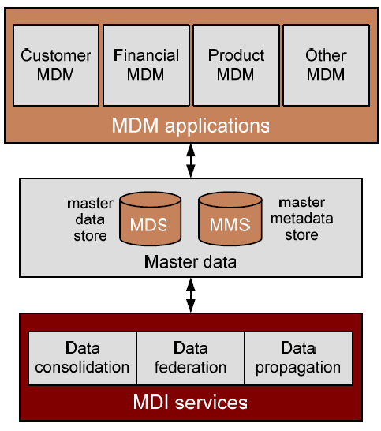
MDM Components

Slide 25
Data Munging
Businesses’ most profound need
- to have their data organized,
- standardized,
- and consolidated with systems for data quality.
These tasks are referred to as data munging.
Data munging or data wrangling is loosely the process of manually converting or mapping data from one "raw" form into another format
-allows for more convenient consumption of the data with the help of semi-automated tools.
Data munging; a process with a set of general steps:
- begins with extracting the data in a raw form from the data source,
- "munging" the raw data using algorithms or
- parsing the data into predefined data structures,
- finally depositing the resulting content into a data sink for storage
and future use
https://en.wikipedia.org/wiki/Data_wrangling
http://inquidia.com/technology-portfolio/data-scientist-toolkit/data-munging-technologies

Slide 26
Typical Munging Tasks
Short list of typical data munging tasks, but there potentially are many
more depending on the data:
* Data sampling
* Create new variables
* Discretize quantitative variables
Date handling (e.g. changing dates stored as integers to R date
objects) Merge, order, reshape data sets
Other data manipulations such as changing categorical variables to
multiple binary variables
* Handling missing data
* Feature scaling
Dimensionality reduction
* http://insidebigdata.com/2014/06/05/data-munging-exploratory-data-analysis-feature-engineering/

Slide 27
Data Wrangling
https://www.trifacta.com/products/

Slide 28
Trifacta
6 step guide to data wrangling using Trifacta Wrangler's features:
Discovering: Learn what's in your raw dataset to think ahead about the best approach for your analytic explorations.
Will enable to understand unique elements of the data such as outliers and value distribution to inform the analysis process.
2. Structuring: This is a critical step because your data comes in all shapes and sizes, and it is up to you to decide the best format to visualize and explore it. Separating, blending, and un-nesting are all important actions in this step.
3. Cleaning: This step is essential to standardizing your data to ensure
that all inconsistencies (such as null and misspelled values) are
addressed. Other data may need to be standardized to a single format
such as state abbreviations.
https://www.trifacta.com/wrangle-data/data-munging

Slide 29
6 step guide to data wrangling (contd.) by TRIFACTA
4. Enriching: At this point, you've gotten a clear handle on your data - what else could you add to provide more value to your analysis? Enrichment is often about joins and complex derivations. For example, if you're looking at biking data, perhaps a weather dataset would be an important factor in your analysis.
5. Validating: Verify if you've caught all of the data quality and consistency issues and go back to address anything you may have missed. Validation should be done on multiple dimensions.
6. Publishing: This is where you can download and deliver the results of your wrangling effort to downstream analytics tools. Once you've published your data it's time to move onto the next step: analytics!
https://www.trifacta.com/wrangle-data/data-munging

Slide 30
Data Munging with R
Exercise:
Go to this URL and study
file:///G:/For%20Analytics%20Course/Data%20Munging%20with%20R.pdf
Exploratory Data analysis
Open source R has its limitations with respect to performing data
munging on large data sets.
Sometimes a good option is to perform transformations outside the R
environment, possibly at the data warehouse level using Extract,
Transform and Load (ETL) steps based on SQL stored procedures.
Once the data is in shape, then it can be imported into R.
ttp://insidebigdata.com/2014/06/05/data-munging-exploratory-data-analysis-feature-engineering/

Slide 31
Simple but Powerful Big Data Techniques
Look At the Data - assess the format and general organization of the file.
Download and study the “readme” or index files, or their equivalent. - purpose, contents, and organization
Assess the number of records in the Big Data resource
curse of dimensionality: individual records contain mountains of data (e.g., sequences, molecular species, images, and so on), but the number of individual records is woefully low (e.g., hundreds or thousands).

Slide 32
Determine how data objects are identified and classified
If you know the identifier for a data object, you can collect all of the information associated with the object, regardless of its location in the resource.
If other Big Data resources use the same identifier for the data object, you can integrate all of the data associated with the data object, regardless of its location in external resources.
Furthermore, if you know the class that holds a data object, you can combine objects of a class and study all of the members of the class.

Slide 33
Determine whether data objects contain self-descriptive information.
All values should be described with metadata, all metadata should be defined, and the definitions for the metadata should be found in documents whose unique names and locations are provided.
The data should be linked to protocols describing how the data was obtained and measured

Slide 34
Assess whether the data is complete and representatives
tudy raw data, you can spot systemic deficiencies or excesses in the data, if they exist, and you may gain deep insights that would not be obtained by mathematical techniques.
Plot some of the data
assess long-term trends, short-term and periodic trends, the general shape of data distribution, and general notions of the kinds of functions that might represent the data (e.g., linear, exponential, power series)
modify your raw data before it is ready for plotting. Use your favorite programming language to normalize, shift, transform, convert, filter, translate, or munge your raw data as you see fit.

Slide 35
Estimate the solution to your multimillion dollar data project on day 1.
If an estimate cannot be attained fairly quickly, then there is a good chance that the project will fail.
If you do not have the data for a quick-and-dirty estimate, then you will probably not have the data needed to make a precise determination.
apply simple estimators to the problems at hand.

Slide 36
Estimation techniques
Data range: Determine the highest and the lowest observed values in your data collection.
There is always a compelling reason, relating to the measurement of the data or to the intrinsic properties of the data set, to explain where and why the data begin and end.
Denominators:
the number of records in the resource, the number of classes of data objects in the resource, the number of data objects belonging to each class in the resource, the number of data values that belong to data objects, and the size of the resource in bytes.

Slide 37
Frequency Distributions: general types of data: quantitative and categorical.
Quantitative data refers to measurements.
Categorical data is simply a number that represents the number of items that have a feature. For most purposes, the analysis of categorical data reduces to counting and binning.
Zipf distribution
Pareto principle.

